Slide 1
A Goal-Based Framework for Software Measurement

Slide 2
3.1 Classifying Software Measures
Processes are collections of software related activities
Products are any artifacts, deliverables of documents that result from process activities
Resources are entities required by a process activity.

Slide 3
3.1 Classifying Software Measures
Internal attributes of a PPR are those that can be measured purely in terms of the PPR itself.
External attributes of a PPR are those that can be measured only with respect to how the PPR relates to its environment.
Table 3.1 Components of SW measurement

Slide 4
3.1.1 Processes
Process measure we should include
  The duration of the process or one of its activities
  The effort (man hours) associated with the process or one of its activities
  The number of incidents of a specified type arising during the process or one of its activities

Slide 5
3.1.2 Products
Not restricted to the items management is committed to deliver to the customer
Any artifact of document produced during the SW life cycle
  prototype code
  user guides

Slide 6
3.1.2.1 External Product Attributes
Depends on both behavior and environment
Each attributes characteristics should be taken into account
  measuring code reliability - consider the machine (cpu) as well as the operational mode.
  Maintainability of a system - depends on the skill of the maintainers and the tools available

Slide 7
3.1.2.1 External Product Attributes
Other external attributes
  usability
  integrity
  efficiency
  testability
  reusability
  portability
  interoperability

Slide 8
3.1.2.2 Internal Product Attributes
Easier to measure
Size of a document by pages or words
Requirements Specification - length, functionality, modularity, reuse, redundancy, syntactic correctness
Formal Design and Code - same way
Structured of code, module coupling and cohesiveness.

Slide 9
3.1.2.3 The Importance of Internal Attributes
Must be able to apply accurate and meaningful measures to Internal product attributes.
Two SWEN structure aspects of development
  Development process - produce products at stages
  Products themselves - product must meet a standard
Have not clearly established the connection between internal attribute values and the resulting external attribute values.

Slide 10
3.1.2.4 Internal Attributes and Quality Control and Assurance
Developers want to use internal attributes to predict external attributes so they can monitor and control the process and products during development.

Slide 11
3.1.2.5 Validating Composite Measures
Quality is an internal attribute of design or code
Quality is so multi-dimensional it does not reflect a single aspect of a particular product
Quality must be measured in terms of
  measuring code size
  complexity etc.

Slide 12
3.1.3 Resources
Measures of any input for the software production
  Personnel
  materials
  tools
  methods
  cost

Slide 13
3.2 Determining What to Measure
Measurement is only useful if it helps improve the process or the resultant product.
Recognizing improvement of the process or product occurs when the project has a clearly defined set of goals for the process or product.
Keeps you going in the right direction

Slide 14
Goal-Question-Metric
The GQM approach to process and metrics has proven to be a particular effective approach to selecting and implementing the metrics.
To use GQM, You express the overall goals of your organization Ask relevant questions Measure.

Slide 15
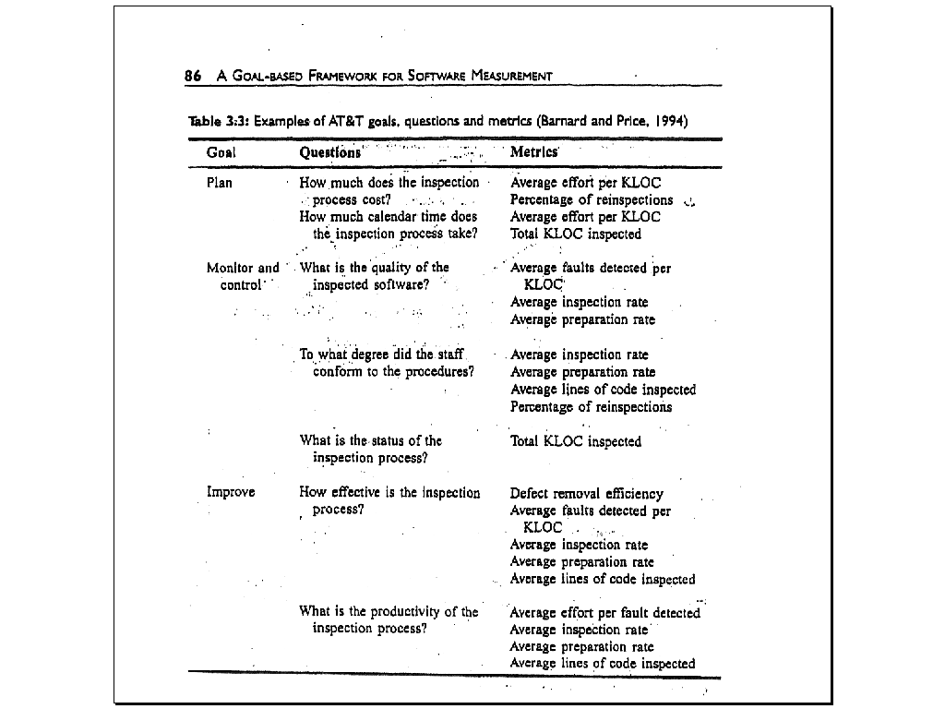
Examples Of AT&T goals, questions and metrics

Slide 16
Measurement and Process Improvement
The Software Engineering Institute has suggested that there are five levels of process maturity.
These levels of are: ad hoc, repeatable, defined, managed and optimized.
The SEI distinguishes one level from another in terms of key process activity going on at each level.

Slide 17
Software Measurement Validation
Even when you know which entity and attribute you want to assess, there are many measures from which to choose.
Measures or measurement systems are used to assess an existing entity by numerically characterizing one of more of its attribute.
Prediction systems are used to predict some attribute of a future entity, involving a mathematical model with associated prediction procedures.

Slide 18
Software Measurement Validation (con’t)
The formal requirement for a validating measure involves demonstrating that it characterizes the stated attribute in the sense of measurement Theory.
To validate the prediction system formally you must first decide how stochastic it is, and then compare performance of the prediction system with known data points.

